Slide 1
The structure of a scientific paper
Fish 290
Thursday January 16th

Slide 2
A scientific paper has three rather independent parts. This fact is critically important when you set out to write a paper, or to read one.
Title: Fishing for readers
Abstract: The “Reader’s Digest” version
The body of the paper: the whole story

Slide 3
What to write first?
Although, in published form, the Title comes first and the Abstract second, they are often written (or finalized) last.
The body of the paper is almost always tackled first.

Slide 4
The body of the paper in a typical journal*
Introduction
Materials and Methods
Results
Text
Tables
Figures
Discussion
Acknowledgements
References Cited
These sections should be familiar to you.
But each section is also sub-structured in a deliberate way

Slide 5
We will now consider all the elements, in order.
In subsequent class sessions, we will examine each one again in detail, using the published papers that you have chosen as examples to see how they are organized and written, what works and what does not, etc.

Slide 6
The Introduction
Begin with the broadest scope and get progressively narrower, leading steadily to the statement of objectives in the last paragraph of the Introduction.

Slide 7
Statement of objectives in the Introduction: The key to the whole paper
The last Introduction’s paragraph must flow from the rest of the section and transition to the description of the study’s methods. It is critical that the goals and objectives be stated clearly and, if applicable, quantitatively.
To repeat, this paragraph is a keystone of the paper.

Slide 8
Examples of objectives:
Not so good:
The purpose of this study is to see if the fishes were different in three Puget Sound beaches.
Better:
The overall goal of the study was [note past tense] to test the hypothesis that eelgrass density was positively correlated with fish species diversity and density. Specifically, we sampled the fish community and measured the density of eelgrass as well as physical habitat variables in eight beaches within Puget Sound. These data were [note plural] used to build a statistical model…

Slide 9
The Methods (or Materials and Methods)
This section describes what was done, how, when and where.
Functions of the M&M:
Allow replication of the study in the future
Give readers the information they need to contextualize the Results. Each result should have a set of methods attached to it.
Allow readers to judge the credibility of the science. Is your approach defensible and appropriate to answer the question? Think about the jury in a courtroom.
Many ways to structure M&M, depends on your study

Slide 10
The Results
Verbal description of the findings of the study as they pertain to the hypotheses and goals
Usually given in the order in which the hypotheses were posed. May also follow order of M&M
Also includes Tables and Figures (as needed)
Give results of statistical analyses to back up claims
Very little interpretation! Stick to the facts.

Slide 11
The Discussion
Begin by interpreting the data with respect to the specific objectives of the study. Then get progressively broader, interpreting papers by others, ending with the concepts used to start the Introduction.

Slide 12
Acknowledgments *
Common professional courtesy (distinct from authorship, though this can be contentious)
People who contributed field help, lab help, ideas, statistical help, etc. but whose contributions were less than those expected for co-authorship**
Only professional, not emotional help (unlike a book)
Also indicates source of financial support (grant numbers if relevant)
* Typically spelled “acknowledgements” in British Commonwealth countries
** We’ll cover authorship ethics later on

Slide 13
References Cited (or Literature Cited)
Acknowledges the work done by others
Allows the reader to learn more
Bolsters arguments and facilitates interpretation of results in context of what is already known
Note that while APA is always used, every journal has their own specific formatting rules
Everything cited in the paper must be listed, and nothing else. This is not a list of relevant papers on the subject, only the ones actually referenced in the paper. They are typically listed in alphabetical order, in the format specified by the selected journal (though some journals number them in the order cited).

Slide 14
The 5 pivotal paragraphs of a journal article
https://dynamicecology.wordpress.com/2016/02/24/the-5-pivotal-paragraphs-in-a-paper/

Slide 15
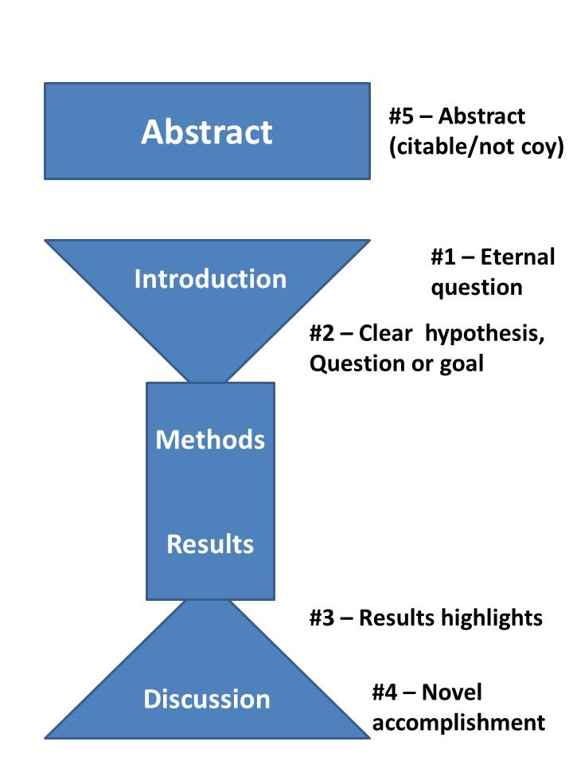

Slide 16
Assignments for today and for home
Read the “5 pivotal paragraphs” blog post. Find and highlight these paragraphs in the paper you chose for your poster.
Prepare a 2 minute verbal summary of your poster paper to describe out loud with no slides, and ideally no reading from a script.
You should cover the main parts of the paper briefly – why the study was done (intro and objectives), how it was done (methods), what was found (results) and implications (discussion). We will be timing you on Tuesday!
Continue doing research for your project, looking for data

